Slide 1

Hand Tracking and Object Detection for Assembly Process and Steps Verification
Final Report
Reporter: YE QING
Date：4/14/2025
Supervisor: Prof. Ong , Prof. Nee
Notes:
"Good afternoon, everyone. I am Ye Qing, and today I'll be presenting my final report on 'Hand Tracking and Object Detection for Assembly Process and Steps Verification'.

Slide 2

CONTENTS
1. Problem Statement & Motivation
2. Research Objectives
3. Methodology Overview
4. Experimental Results
5. System Integration: User Interface
6. Conclusion & Future Work
Notes:
Here's a roadmap for today's presentation,containing......

Slide 3
01
Problem Statement & Motivation

Slide 4
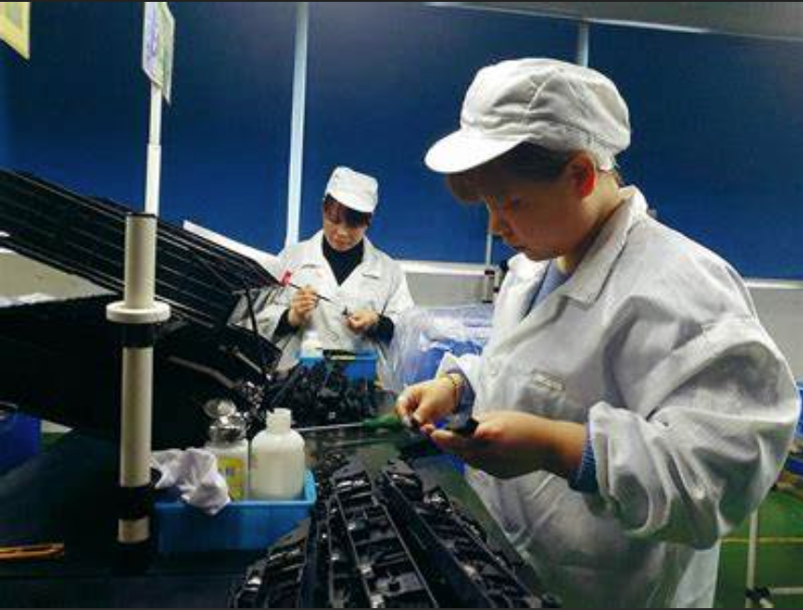

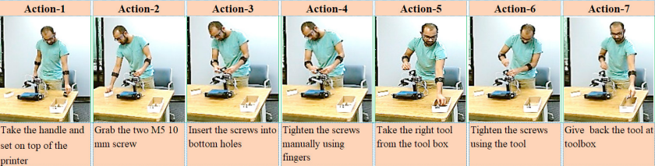
Problem Statement
Research Objectives
Methodology Overview
Experimental Results
System Integration
Conlusion &
Future plan
Problem Statement & Motivation
Human-centric manufacturing
(Industry 4.0)
Challenge: Manual assembly QA is critical but error-prone, lacks objective measures.
Need: Robust, automated systems for verifying procedural correctness and quality in flexible manufacturing.
Goal: Develop a vision-based system integrating hand tracking and object detection for real-time assembly verification.
Notes:
Manual quality assurance in assembly is essential but faces significant challenges. It's often prone to human error and lacks objective, quantifiable measures. In modern manufacturing, especially with the rise of human-centric approaches like Industry 4.0 . there's a pressing need [Source 38] for robust, automated systems that can verify procedural correctness and ensure high quality in flexible environments. Therefore, our goal [Source 39] was to develop an integrated, vision-based system using hand tracking and object detection for effective, real-time assembly verification.

Slide 5
02
Research Objectives

Slide 6
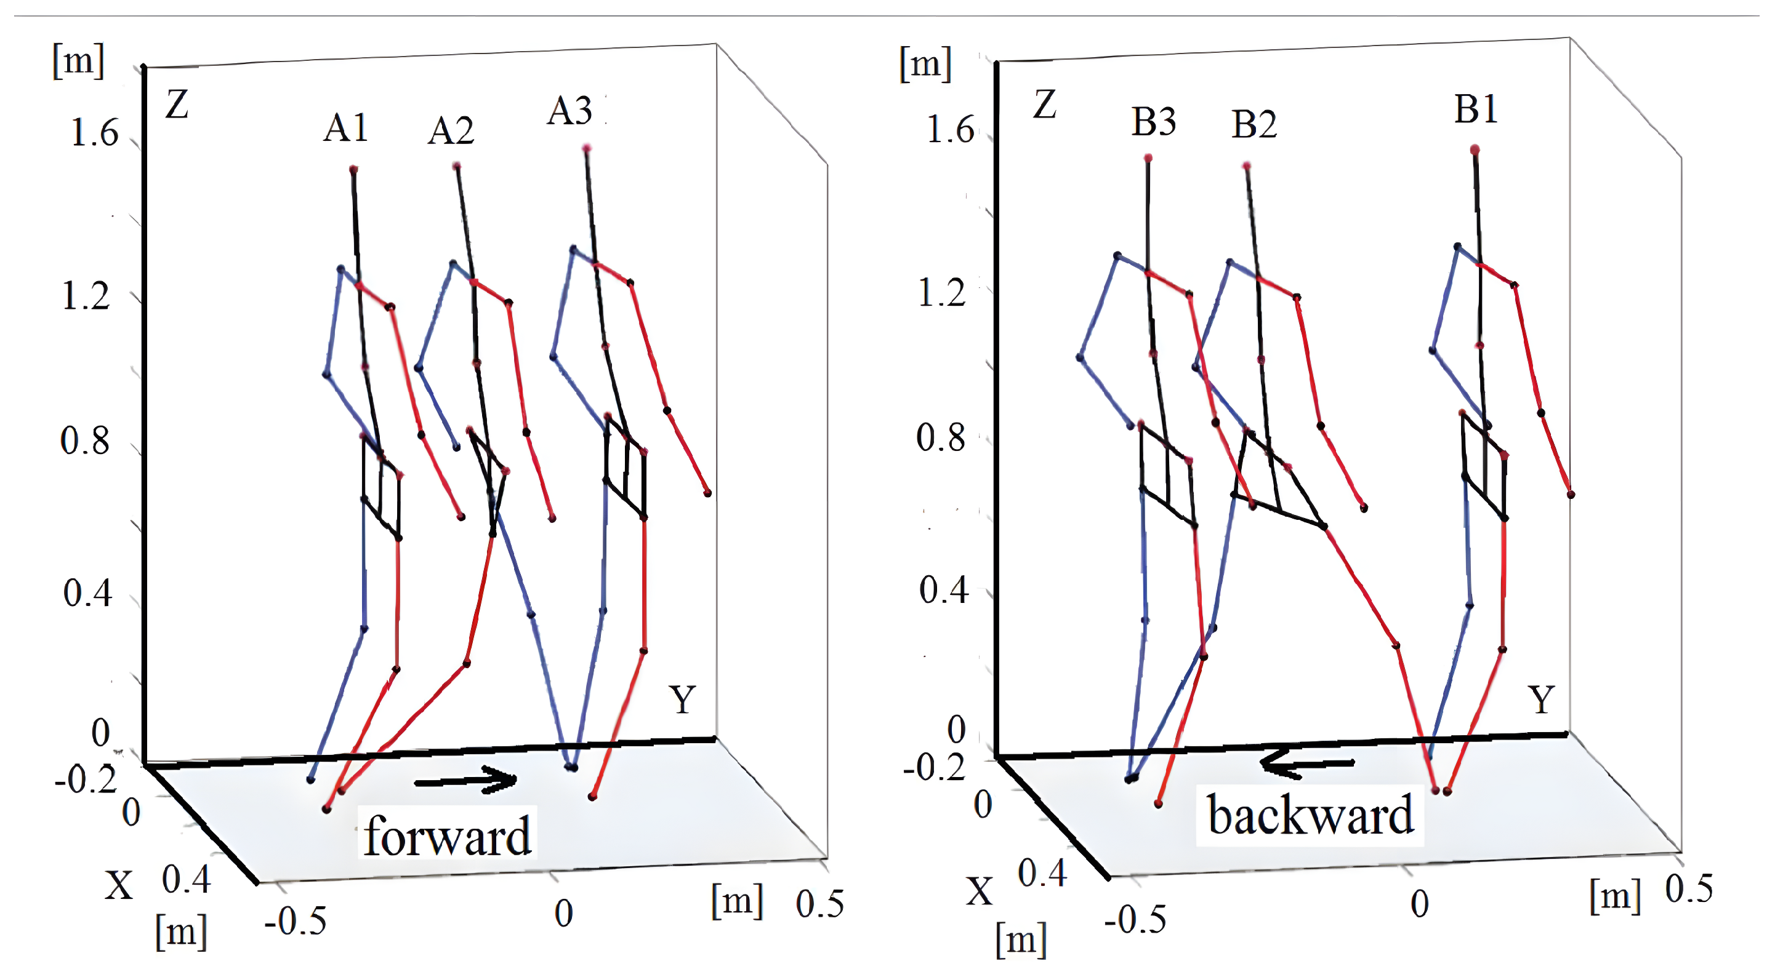
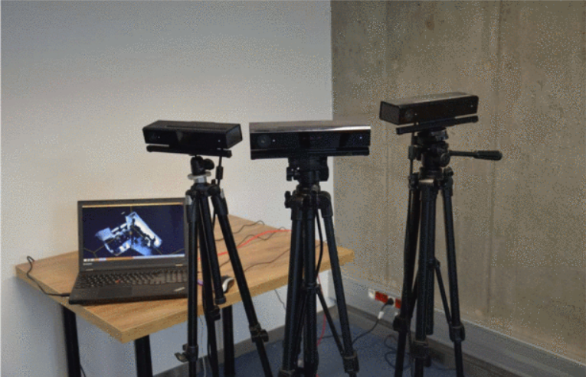
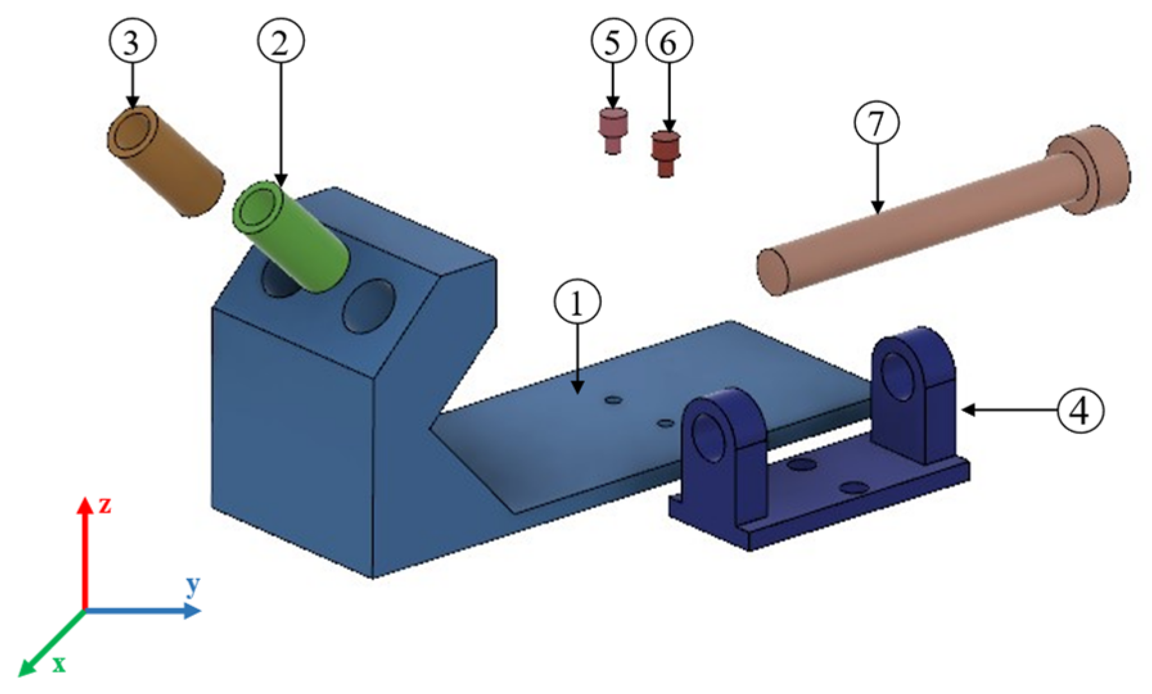
Problem Statement
Research Objectives
Methodology Overview
Experimental Results
System Integration
Conlusion &
Future plan
Two camera
tracking
Research Objectives
Multi-sensor system for robust 3D hand kinematic data acquisition
Accurate assembly stage identification method
A quantitative method for assessing operator motion
Integrate 3 components into a functional system with a user interface for operator guidance and feedback.
Notes:
"To achieve this goal, we set out four main research objectives [Source 41]:
First, to develop a multi-sensor system capable of robustly acquiring 3D hand kinematic data.
Second, to create an accurate method for identifying assembly stages
Third, to implement a quantitative technique for assessing operator motion against standard procedures.
And finally, to integrate these three core components into a functional system featuring a user interface for operator guidance and feedback."

Slide 7
03
Methodology Overview:

Slide 8
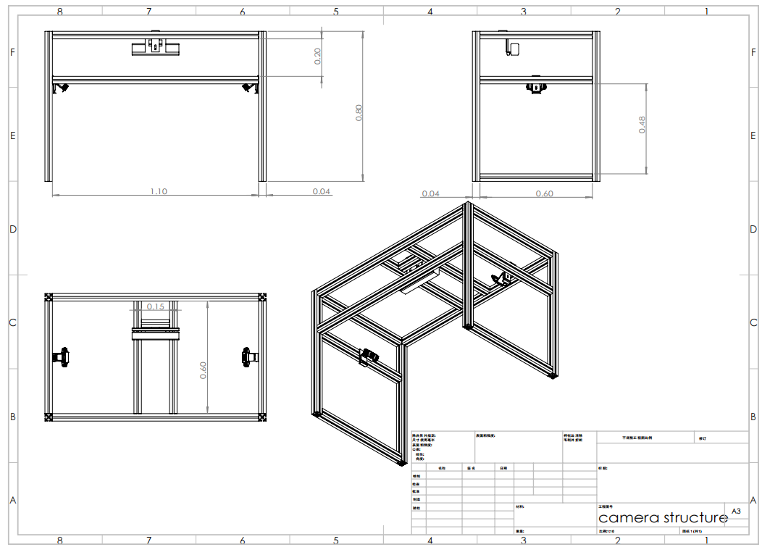
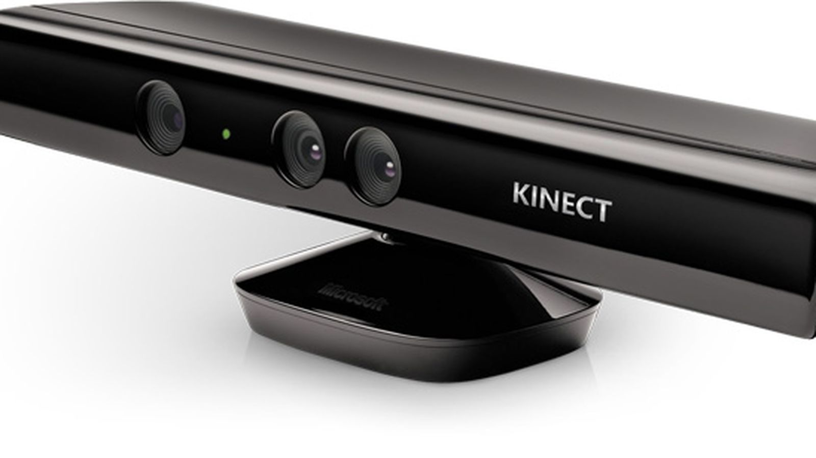
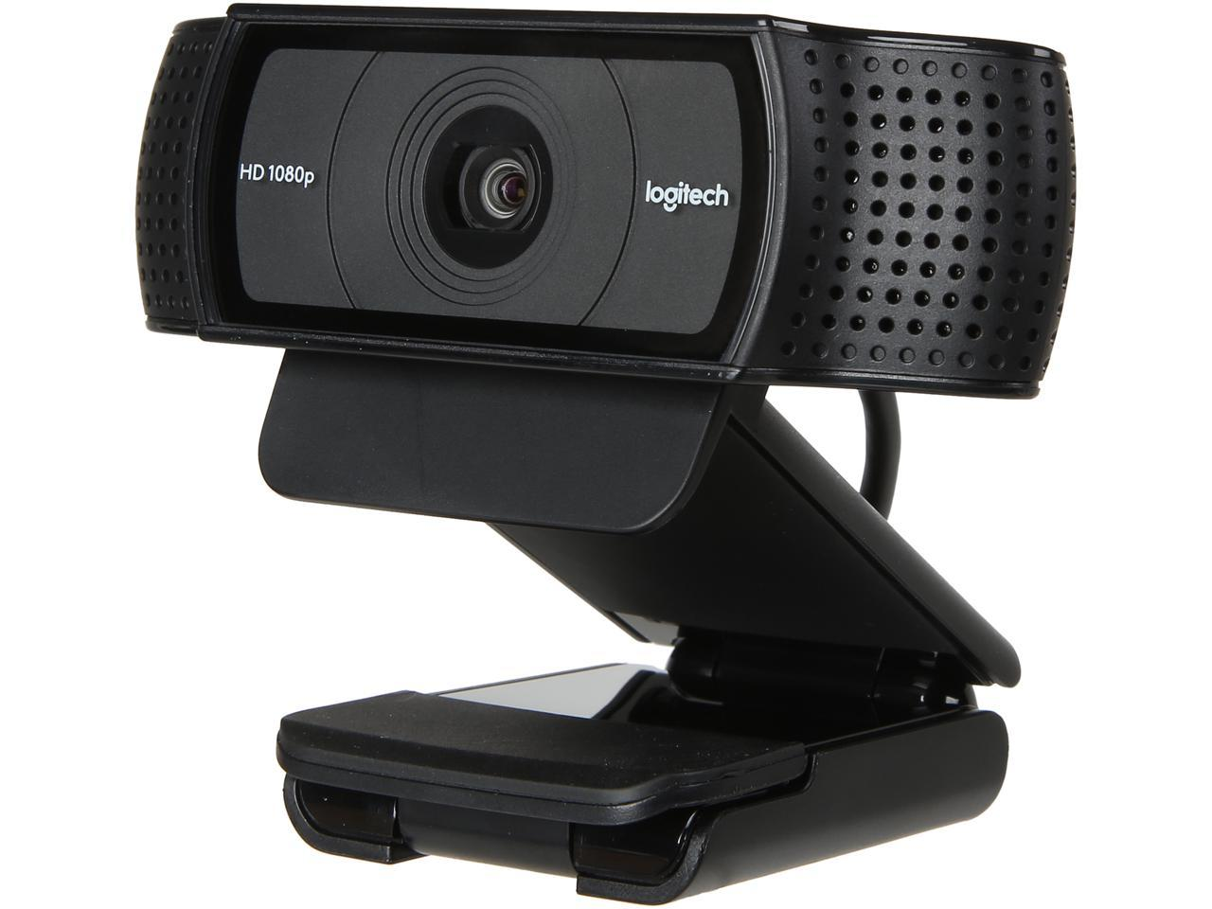
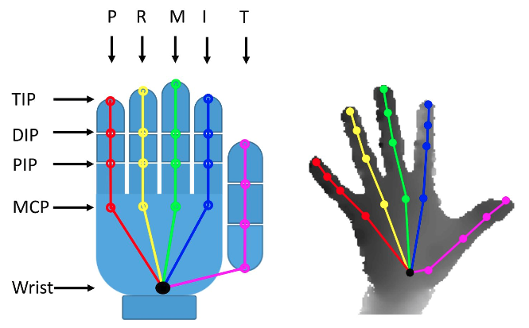

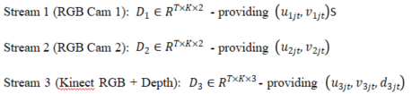
Problem Statement
Research Objectives
Methodology Overview
Experimental Results
System Integration
Conlusion &
Future plan
Data Acquisition & 3D Reconstruction
Hardware: Custom framework with Kinect + 2x Logitech C920 Pro
2D Keypoints: MediaPipe (21 landmarks, confidence threshold 0.6, max_hands = 2)
2D keypoint coordinates for both hands are obtained from each RGB camera. 3D keypoint coordinates for both hands are captured by the Kinect sensor.
The acquired data includes:
Notes:
For data acquisition, we designed a custom hardware framework using a Kinect sensor combined with two Logitech C920 Pro RGB cameras [Source 43]. This multi-view setup helps mitigate issues caused by occlusions.
We utilize MediaPipe [Source 43] to detect 2D keypoints for both hands from each RGB camera stream. As noted [Source 44], 2D coordinates are captured by the RGB cameras, while the Kinect sensor provides corresponding 3D coordinates for both hands. The system is configured to handle up to two hands with a confidence threshold of 0.6. It provides 2D and 3D data streams

Slide 9
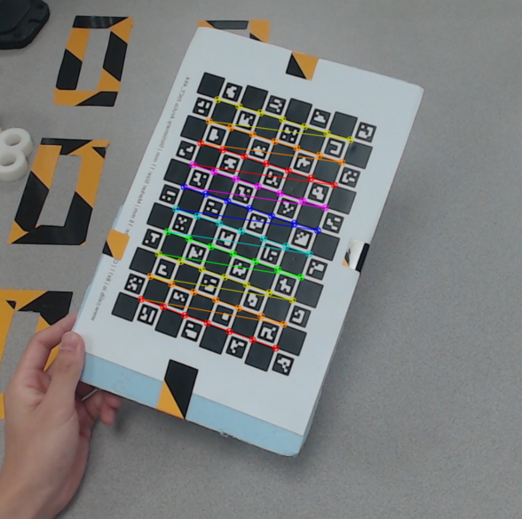
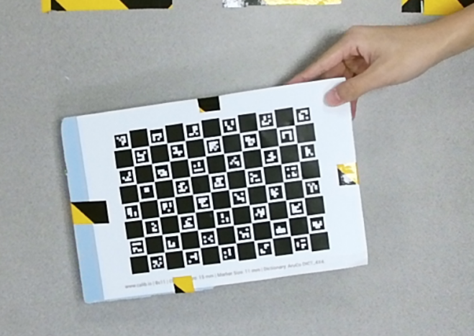
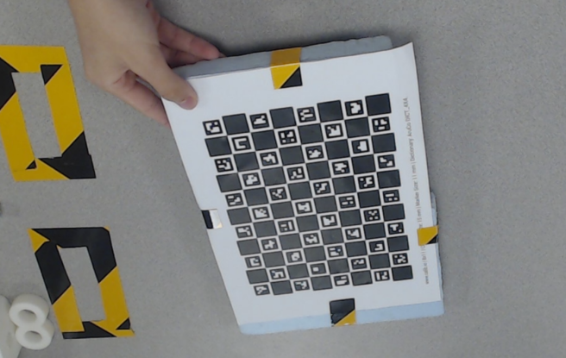
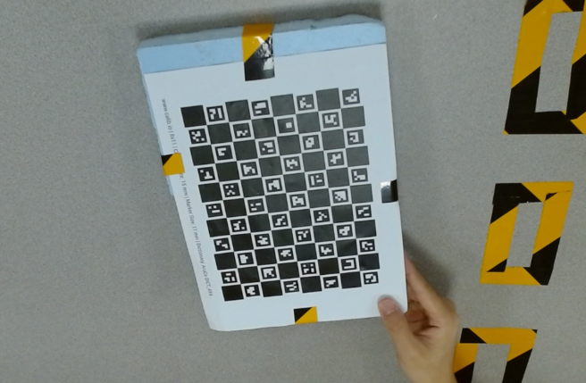
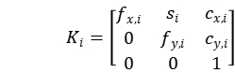
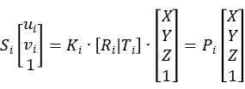
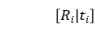
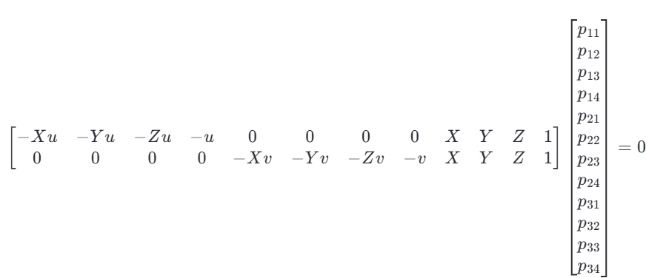
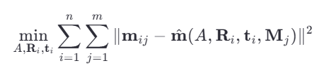
Problem Statement
Research Objectives
Methodology Overview
Experimental Results
System Integration
Conlusion &
Future plan
Data Acquisition & 3D Reconstruction
Calibration:Intrinsic/Extrinsic parameters determined using chessboard method
Extrinsic parameter calibration
1. Each camera captured 15 images individually for intrinsic parameter caculation.
2. The 3 cameras also captured 15 sets of images simultaneously (from different viewpoints) for extrinsic parameter caculation.
Intrinsic parameter calibration
Intrinsic matrix
, DLT method：
, Extrinsic matrix is:
At least 6 pairs of points (12 equations) can be used to calculate the extrinsic parameter matrix.
Zhang's method: Uses non-linear least squares to minimize the reprojection error.
Notes:
Accurate 3D information relies on precise calibration. We performed both intrinsic [Source 47] and extrinsic [Source 48] calibration using the standard chessboard method. This involved capturing images individually from each camera for intrinsic parameters [Source 48, point 1] and simultaneously from all three views for extrinsic parameters [Source 49, point 2]. T
here is a well-developed library to implement this part, and I only need to input these 15 photos to get the result
There are 12 unknown parameters

Slide 10
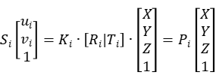
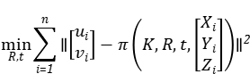
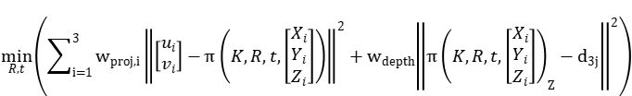

Problem Statement
Research Objectives
Methodology Overview
Experimental Results
System Integration
Conlusion &
Future plan
Data Acquisition & 3D Reconstruction
Data Fusion:
Temporal Smoothing of 3D Trajectories:
Following frame-by-frame 3D reconstruction, SVD is applied to the resulting hand keypoint time-series matrix.
Non-linear least squares to
minimize the error.
$$A=UΣV^{T}$$
SVD(Singular value decomposition) method
Add depth information
Temporal smoothing method
Notes:
In our project,we not only have u and v,but the information d is also captured.
Therefore, the error between the obtained value in the z-direction and d should also be considered.
As a result, we derive new parameters to be minimized.

Slide 11
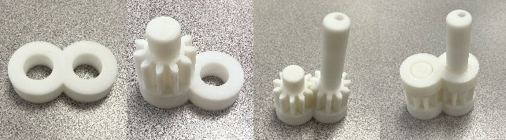
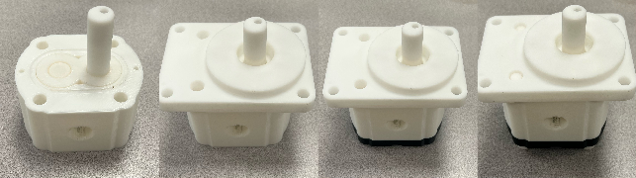
Research Objectives
Methodology Overview
Experimental Results
System Integration
Conlusion &
Future plan
Problem Statement
Two camera
tracking
Assembly State Recognition: Multi-View Sliding YOLO Group
Due to occlusions during the assembly process, it is challenging to identify and localize each individual component.
Using a single YOLO to recognize images across 8 stages results in low accuracy and is prone to skipping assembly stages.
YOLO_n
YOLO_1
YOLO_3
YOLO_5
step n step n+1 step n+2
Disassembly
Assembly
Sliding mechanism activates next/previous model based on consistent detection. Temporal stability filter (N_stable frames = 10) to prevent spurious transitions.
YOLO_2
YOLO_4
YOLO_6
Notes:
To overcome these limitations, we propose a 'Multi-View Sliding YOLO Group' architecture. Instead of a single model, we use multiple specialized YOLOv8s models
. Each model, is trained specifically to recognize only three states: the preceding, current, and subsequent stages (n, n+1, n+2). A 'sliding mechanism' activates the appropriate YOLO model based on consistent detection ， handling both assembly and disassembly sequences. To prevent unstable switching, a temporal stability filter [Source 11] is used, requiring consistent detection for 10 frames before allowing a transition between active YOLO models."

Slide 12
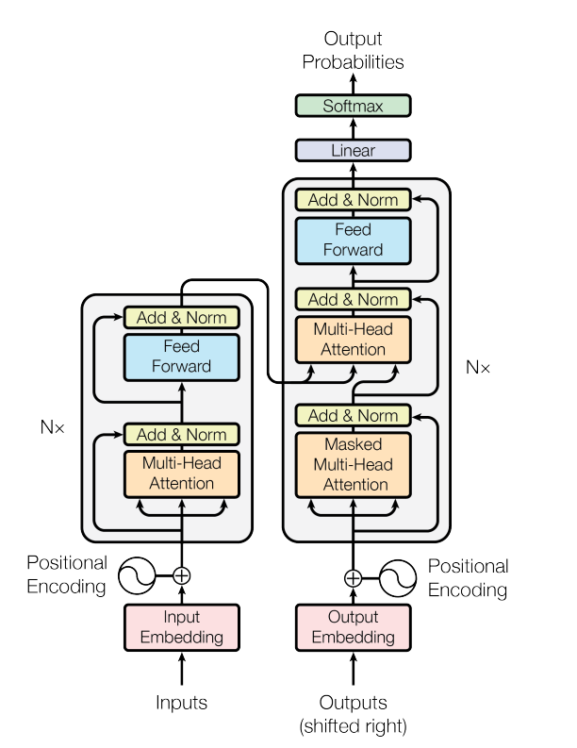
Research Objectives
Methodology Overview
Experimental Results
System Integration
Conlusion &
Future plan
Problem Statement
Two camera
tracking
Motion Similarity Assessment:Transformer Siamese Network
Transformer model struture
Input sequence 1
Input sequence 2
Shared transformer feature extractor
Encoded Features 1
Encoded Features 2
Pooling(mean)
Pooling(mean)
Pooled Features 1
Pooled Features 2
F 1
F 1 - F 2
F 1 + F 2
F 2
MLP Classifier (0/1)
Notes:
Next, we assess the quality of the operator's movements. Classifying every detailed action would require vast amounts of data. So, we opted for a more scalable approach: evaluating the similarity between the performed motion and a standard template. We use a Transformer-based Siamese Network [Source 13] for this.
The network takes two input sequences (e.g., the operator's motion and the standard motion). A shared Transformer feature extractor processes both, capturing complex temporal dependencies using self-attention. The resulting features are pooled, aggregated, and fed into an MLP classifier that outputs a binary score indicating whether the motions are similar.

Slide 13
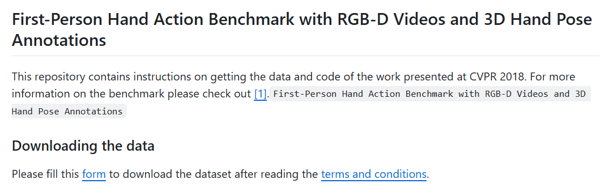

Research Objectives
Methodology Overview
Experimental Results
System Integration
Conlusion &
Future plan
Problem Statement
Two camera
tracking
Training - Based on First-Person Hand Action Benchmark Dataset
RGB 1 captured
RGB 1 captured
RGB 1 captured
3d sequence
Cut (if the sequence is longer than 100)
Pad with zeros (if the sequence is shorter than 100).
Input sequence
The original videos have frame counts ranging from 20 to 200.
To mitigate the impact of data length on experimental results, I further filtered the original dataset to retain time series with lengths between 80 and 120 (closer to 100), thereby reducing the influence of the various sequence length on the experimental outcomes.
It contains 1,331 videos covering 27 distinct motions, which can be used for similarity assessment scoring.
Notes:
We trained this network using the 'First-Person Hand Action Benchmark Dataset' [Source 15], which contains over 1300 videos of various hand actions. We created pairs of sequences for training – positive pairs from the same action class, negative pairs from different classes.
A critical step was handling the variable video lengths, which range from 20 to 200 frames [Source 17]. Initially, we normalized all sequences to 100 frames using zero-padding or truncation [Source 16]. To investigate the impact of this, we also created a filtered dataset [Source 17] retaining only sequences with lengths between 80 and 120 frames, aiming to reduce influence from excessive padding or truncation.

Slide 14
04
Experimental Results

Slide 15
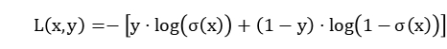
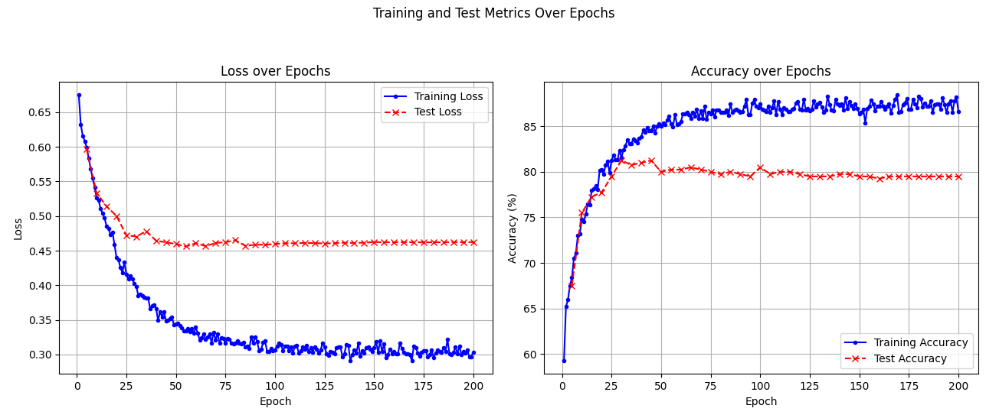
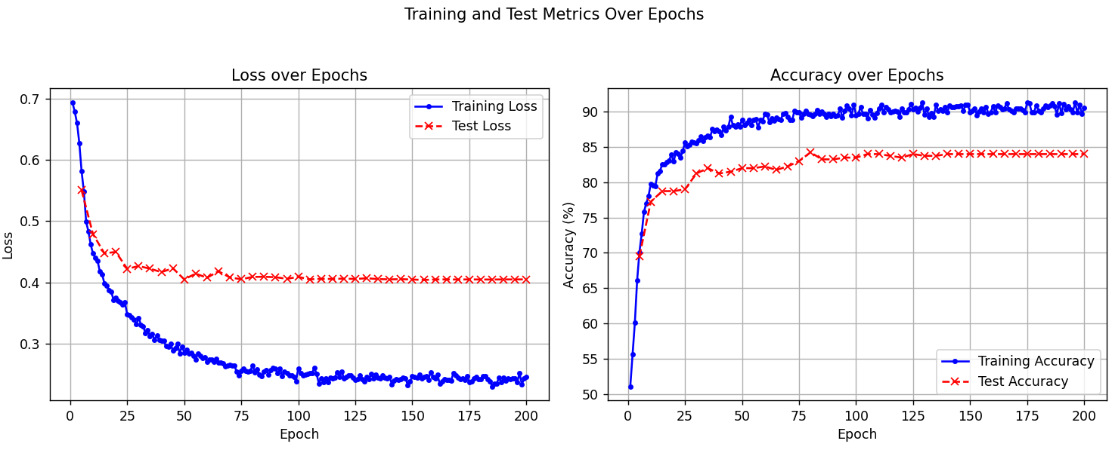
Problem Statement
Research Objectives
Methodology Overview
Experimental Results
System Integration
Conlusion &
Future plan
Results: Motion Similarity (Transformer Model)
Objective: Binary Cross-Entropy Loss.
Epoch-wise training/testing metrics
Epoch-wise training/testing metrics on the modified dataset
The training accuracy converged and stabilized at approximately 87%, with the corresponding training loss settling around 0.3. When evaluated on the unseen test set, the model achieved an accuracy of approximately 80%, with an associated test loss of approximately 0.45.
The results demonstrated a notable improvement compared to the baseline. On the filtered training set, accuracy exceeded 90%, while the training loss decreased to approximately 0.27. Performance on the corresponding filtered test set reaching an accuracy of approximately 84% with a test loss reduced to around 0.40.
Notes:
For the motion similarity task, we trained the Transformer model using Binary Cross-Entropy Loss. On the original dataset (with padding/truncation to 100 frames), the model achieved about 87% training accuracy [Source 23] but plateaued around 80% test accuracy [Source 24], indicating a generalization gap [Image 33].
However, when using the filtered dataset (lengths 80-120), performance markedly improved [Source 25]. Training accuracy exceeded 90% [Source 26], and importantly, the test accuracy increased to approximately 84% [Source 27] with lower test loss [Image 34]. This demonstrates the model's capability for similarity assessment and highlights the sensitivity to how sequence length variations are handled

Slide 16
Problem Statement
Research Objectives
Methodology Overview
Experimental Results
System Integration
Conlusion &
Future plan
Results: State Recognition (YOLO Group vs. Single YOLO)
Training Parameters
Stage | Image_number
stage_1 | 119
stage_2 | 122
stage_3 | 121
stage_4 | 121
stage_5 | 119
stage_6 | 123
Parameters | Value
Epochs | 200
Input Image Size | 640x640 pixels
Training Environment | NVIDIA RTX A4000
Batch Size | 64
Base Model | yolov8s.
Training Dataset:
The dataset is entirely self-made, with annotations done
by myself and Niu Yuqian. (Python Labelimg Lib)
Train:Val:Test=8:1:1
Notes:
For the state recognition task, we trained and evaluated our YOLO Group against a single YOLO baseline. We used a custom dataset [Source 19] that we created and annotated, covering 6 assembly stages. The data was split 80% for training, 10% for validation, and 10% for testing. We used YOLOv8s as the base model with the training parameters shown here [Source 18], including 200 epochs and a batch size of 64

Slide 17
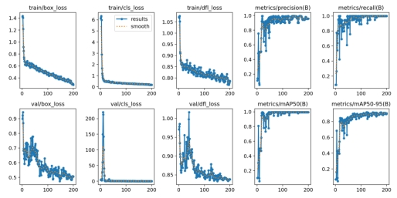
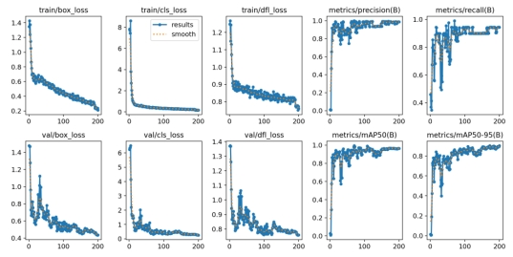
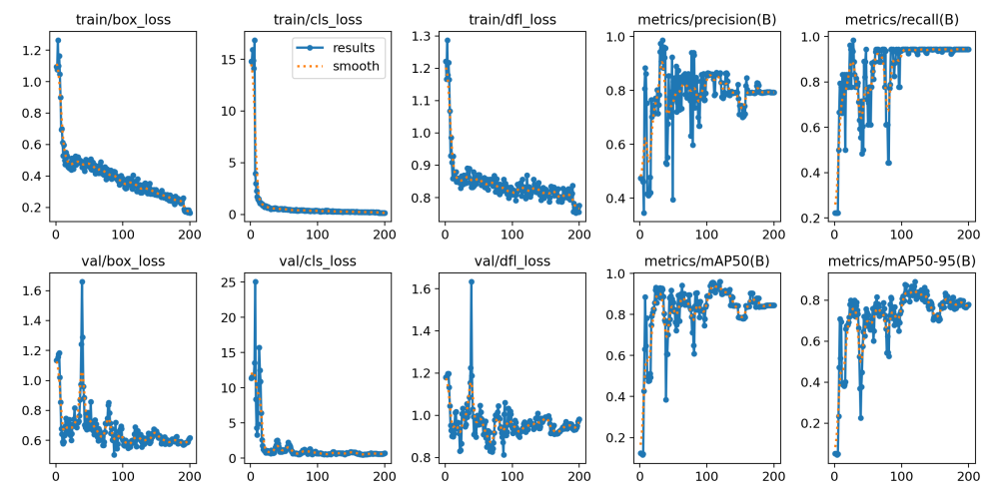
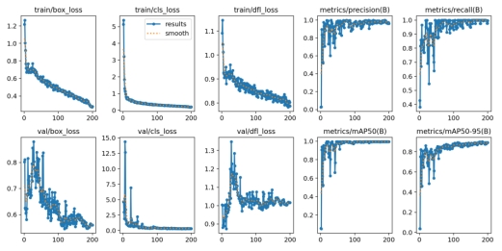
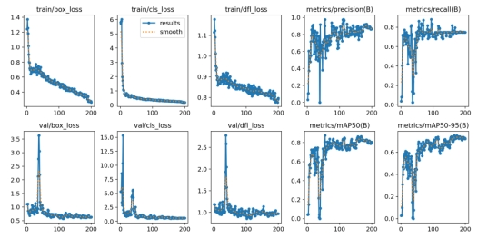
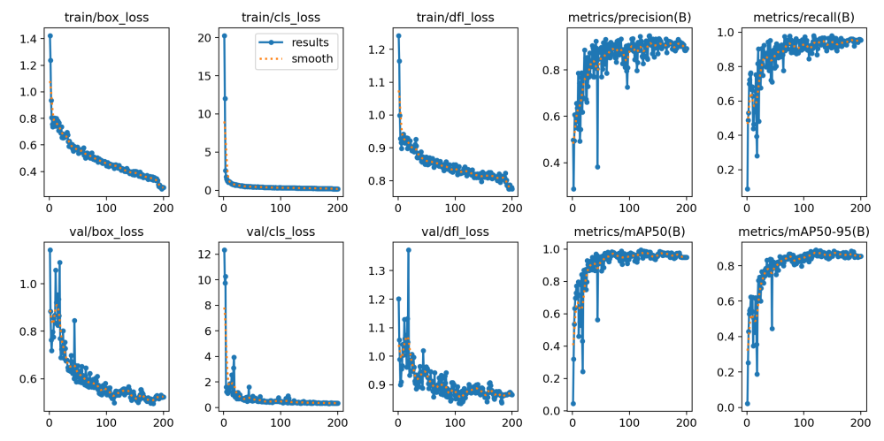
Problem Statement
Research Objectives
Methodology Overview
Experimental Results
System Integration
Conlusion &
Future plan
Results: State Recognition (YOLO Group vs. Single YOLO)
Training result:
Performance was monitored using key metrics including classification loss (cls_loss), bounding box regression loss (box_loss), distribution focal loss (dfl_loss), alongside bounding box precision (P(B)) and recall (R(B)).
Notes:
The training progress for the YOLO models was monitored using standard metrics like classification loss, box loss, precision, and recall]. The learning curves indicated stable convergence and good generalization without significant overfitting.

Slide 18
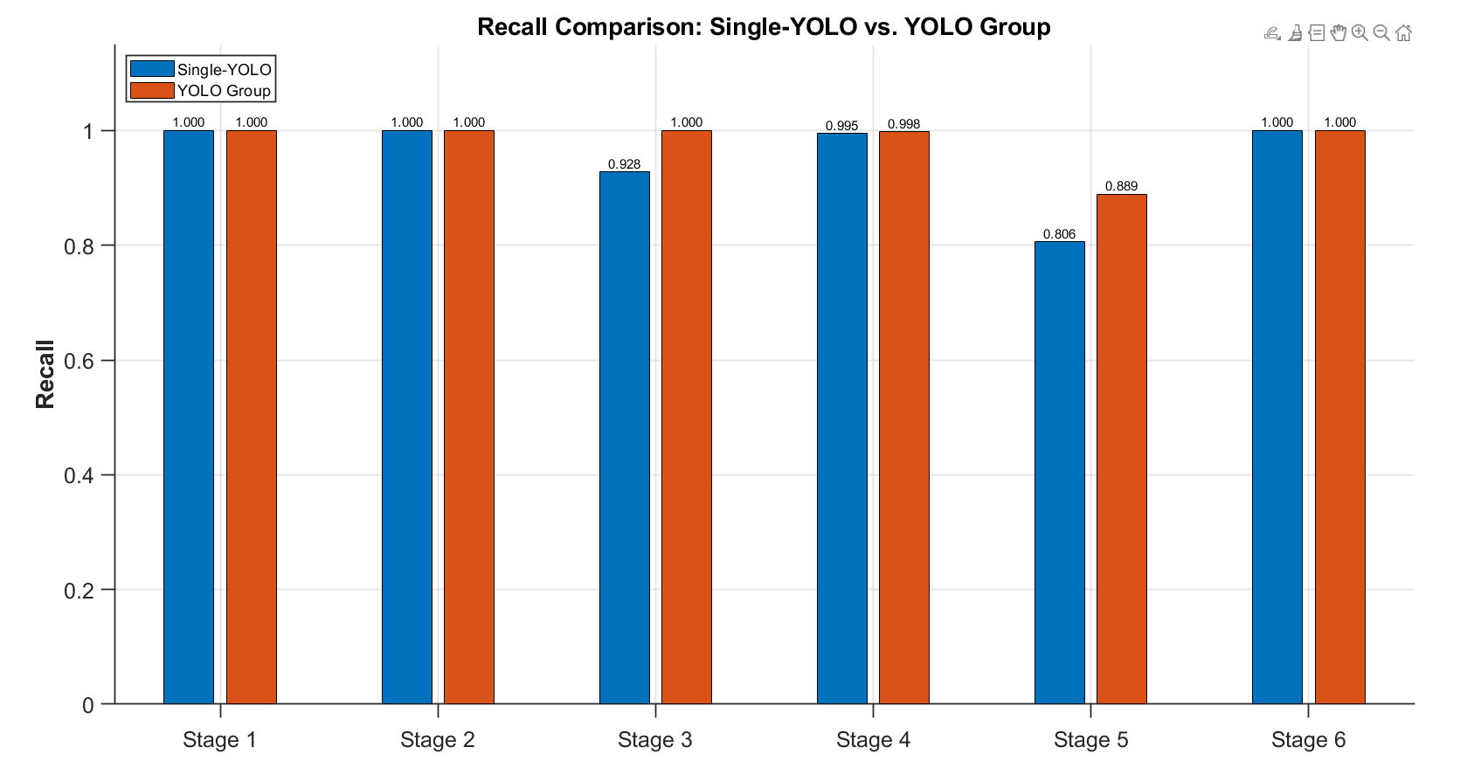
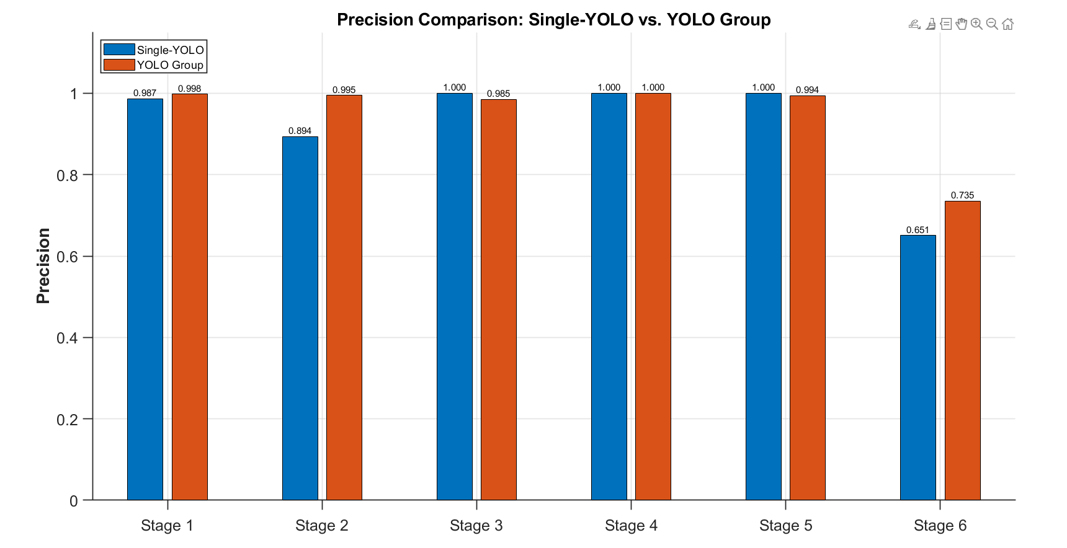
Research Objectives
Methodology Overview
Experimental Results
System Integration
Conlusion &
Future plan
Problem Statement
Two camera
tracking
Results: State Recognition (YOLO Group vs. Single YOLO)
Test result:
Model performance was quantified using Precision (P) and Recall (R)
These results suggest that specializing models on smaller, related subsets of assembly stages enhance discriminative capability, particularly between adjacent states.
Recall comparison: Single YOLO vs Yolo Group
Precision comparison: Single YOLO vs Yolo Group
Notes:
The crucial comparison is the performance on the test set, measured by Precision and Recall ]. As shown in these comparison graphs [Images 38, 39], our proposed YOLO Group significantly outperformed the single YOLO model,This confirms the benefit of using specialized models in a sliding configuration

Slide 19
05
System Integration: User Interface

Slide 20
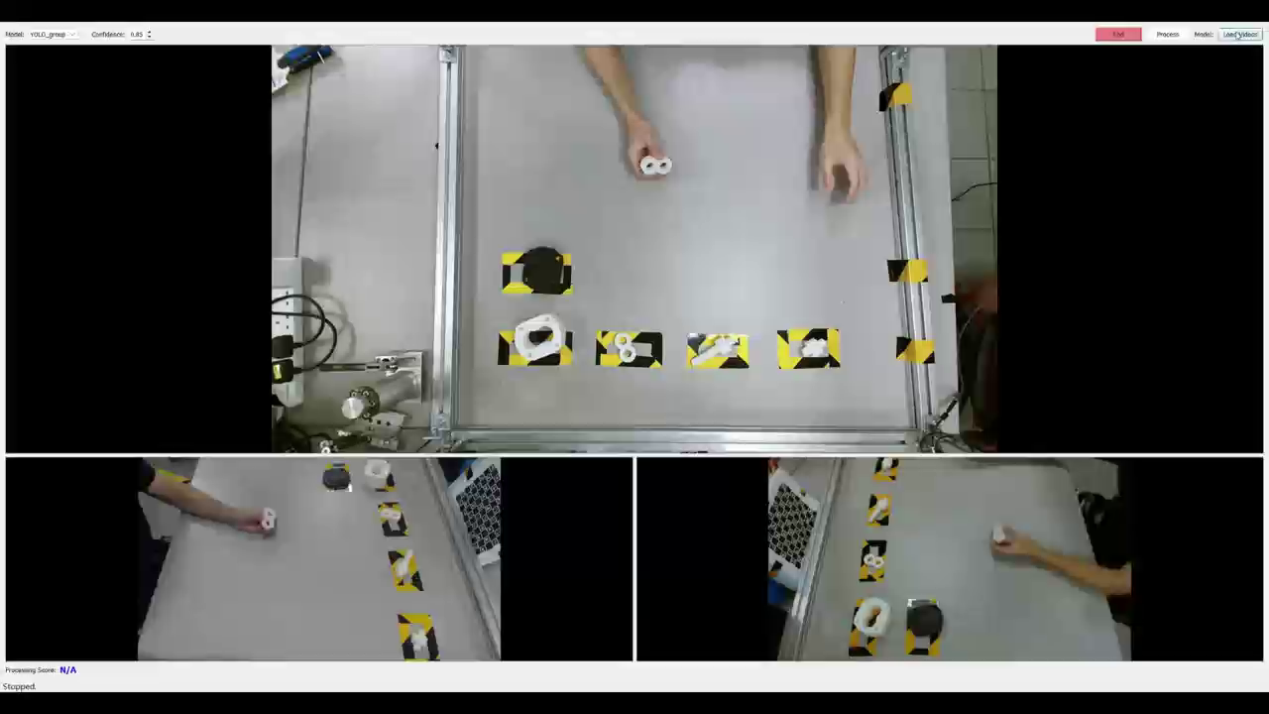
Research Objectives
Methodology Overview
Experimental Results
System Integration
Conlusion &
Future plan
Problem Statement
Two camera
tracking
Automated supervisory control software
PyQt (Python bindings for Qt framework).
Notes:
You can click 'Load', and it will play a video showing the operator how to complete this assembly.
Following this, we have the real-time guidance provided while the operator is working

Slide 21
06
Conclusion & Future Work

Slide 22
Research Objectives
Methodology Overview
Experimental Results
System Integration
Problem Statement
Two camera
tracking
Conlusion &
Future plan
Conclusion & Future Work
The principal contributions and findings of this work are threefold:
1. Optimized Multi-Sensor System for 3D Hand Tracking
The system effectively overcomes the visual field limitations inherent in single-view depth sensing
2. Enhanced Assembly State Recognition via YOLO Group
Utilizes specialized YOLOv8s models focused on sequential stage triplets, improves state classification accuracy
3. Scalable Motion Verification using Transformer-based Similarity
Future Plan and Current Limitation:
1. Bimanual Hand Tracking and Analysis
2.Optimization of Fixed Parameters and Thresholds
3.Develop a custom dataset for an action similarity model.
Notes:
In conclusion, this research presents an integrated vision-based framework for automated assembly verification. Our main contributions include:
1.A notable limitation of the current implementation is its focus on single-hand analysis; both the 3D keypoint reconstruction and the subsequent motion similarity evaluation utilize data pertaining to only one hand. However, numerous industrial assembly operations inherently involve bimanual coordination and interaction. So a significant direction for future research is the extension of the methodology to incorporate keypoints from both hands.
2. The current system employs several parameters and thresholds set empirically or maintained at fixed values throughout my experiments.
3.

Slide 23
THANKS
4/15/2025

